Slide 1
DC2: Polyjet 4D Printing of Coronary stent
Grad Team 3: Raghav Agarwal, Veeresh Ayyagari, Yubo Cao, Camille Levine

Slide 2
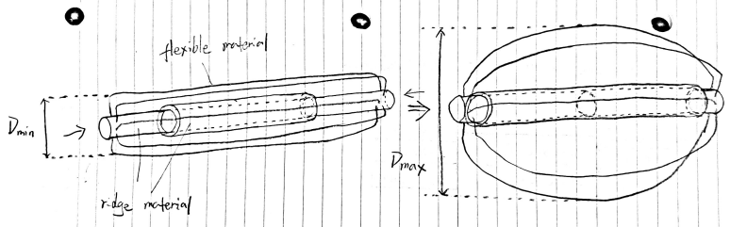
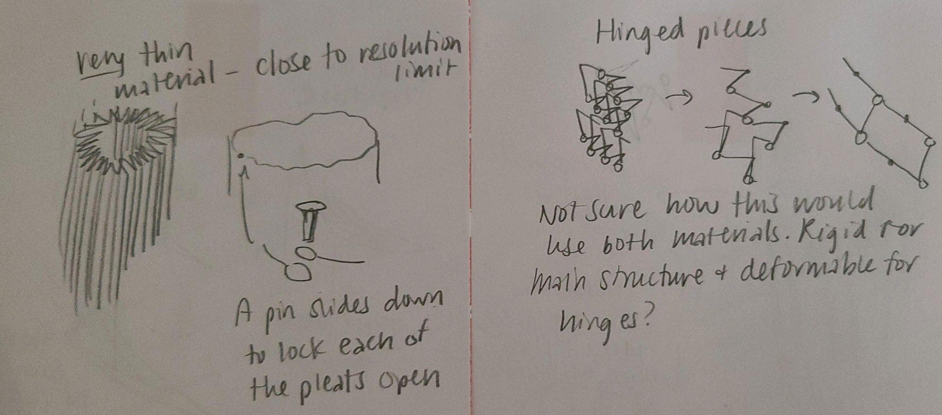
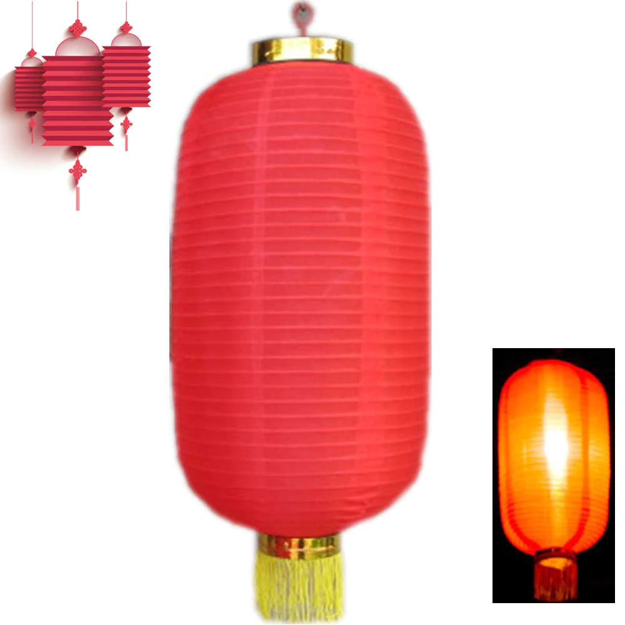
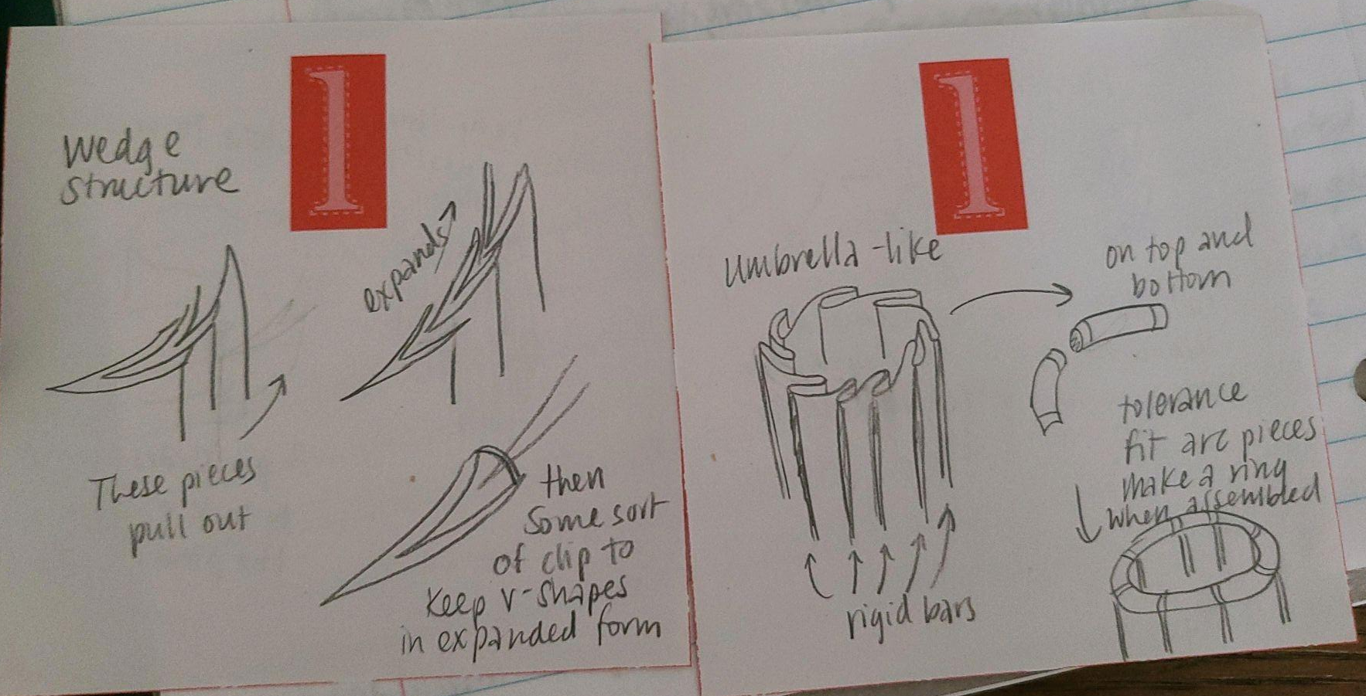
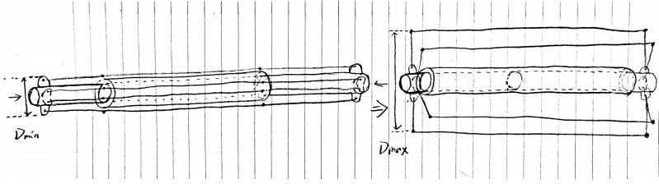
Stent Design Motivation
Lots of different sources of inspiration!
Notes:
We had a lot of different sources of inspiration for this product- a lot of back-of-napkin scribbles. Some of these were inspired by Chinese lanterns or umbrellas, and we got a lot of inspiration from online.

Slide 3
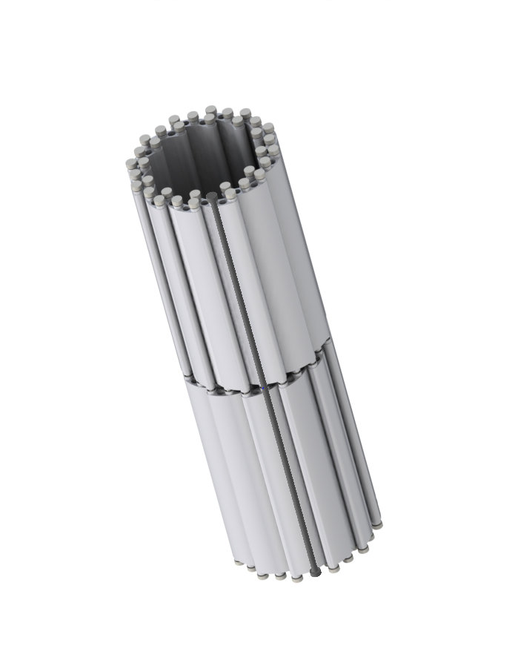
Stent Design
Notes:
We ultimately went with a hinged design similar to this expanding ball toy most of us are familiar with from our childhoods. We then found a Youtube video explaining how to make an expanding linkage mechanism in Solidworks, and how to add constraints. We modified the design to fit within the build plate considerations. As you can see, the upper row of links turn counterclockwise while the lower row turns clockwise.

Slide 4
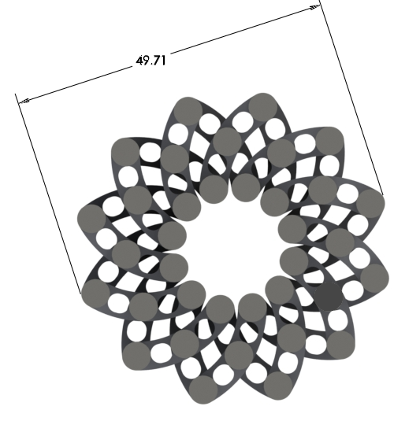
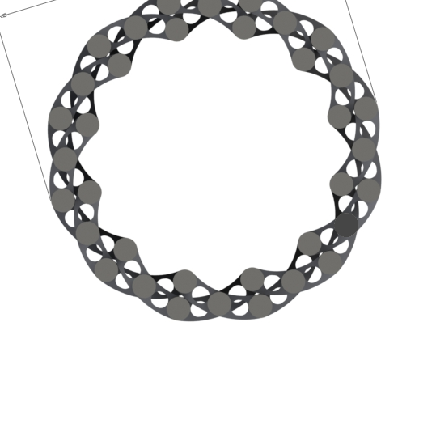
Stent Design
Theoretical diameter ratio: 64.27/49.71 = 1.29
Veroplastic
Agilus

Slide 5
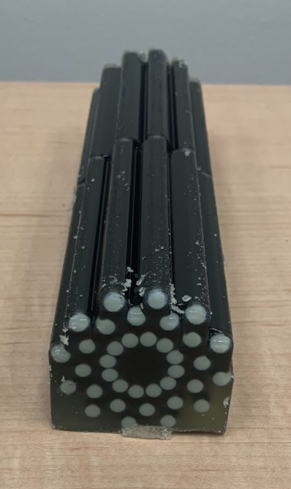
Polyjet 3D Printing Results
After being returned- lots of support material on
lower half of print.
Clearances between screws and members were
also filled with support material as well.

Slide 6
Support Removal Considerations
How did we design so that supports would be easy to remove?

Slide 7
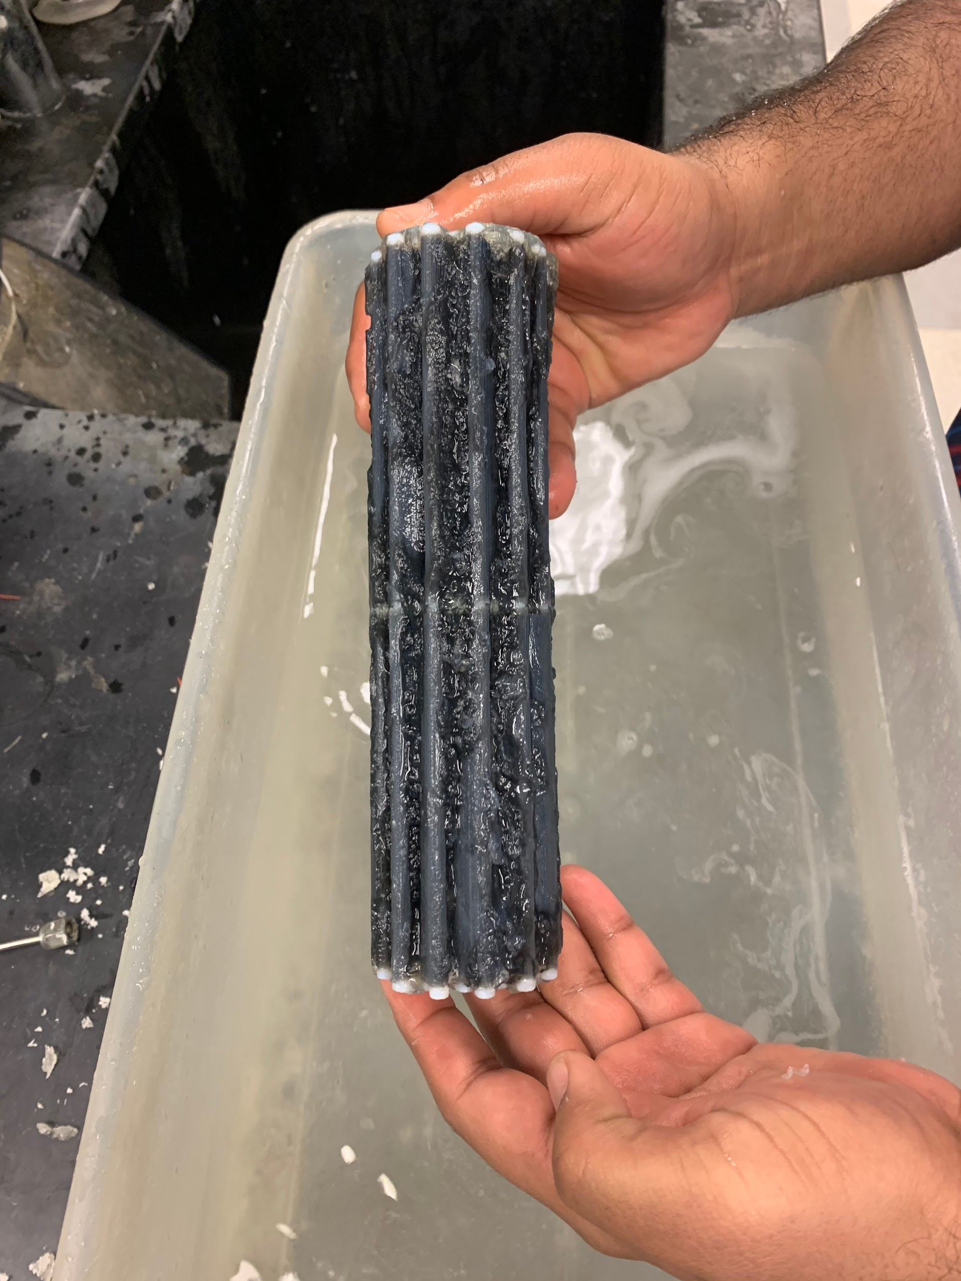
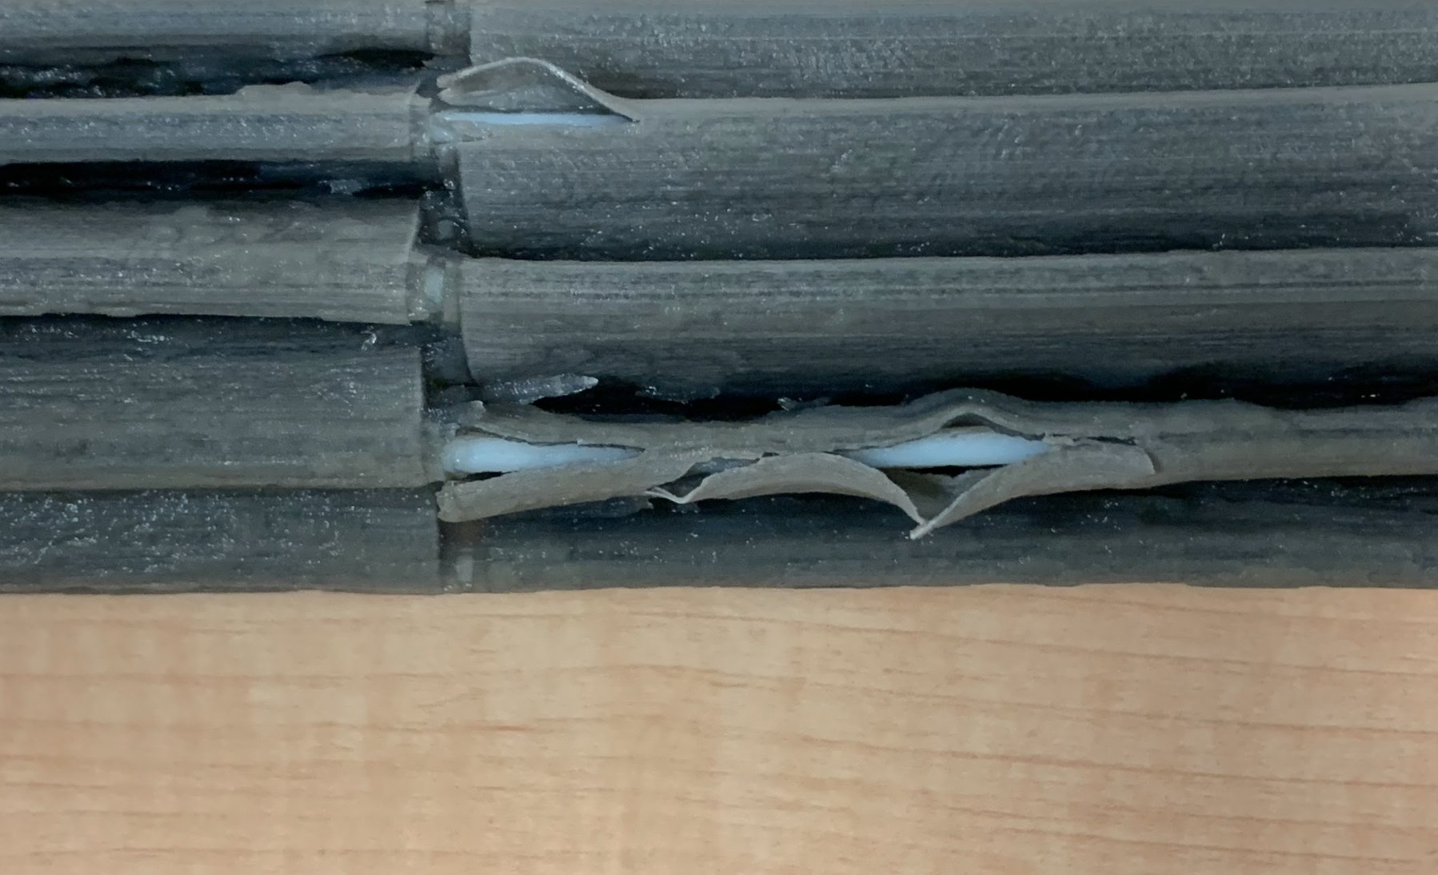
Results of Support Removal
Notes:
Similar issue to UG Team 3

Slide 8
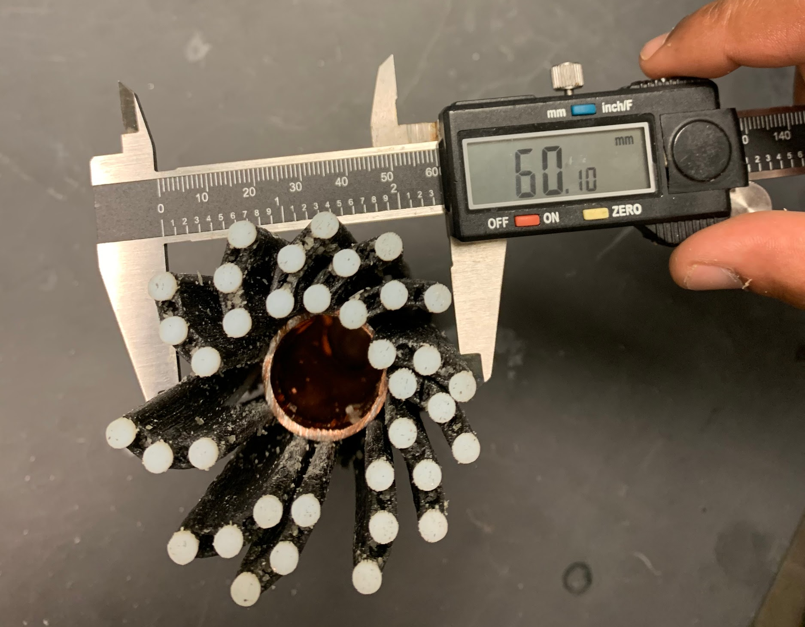
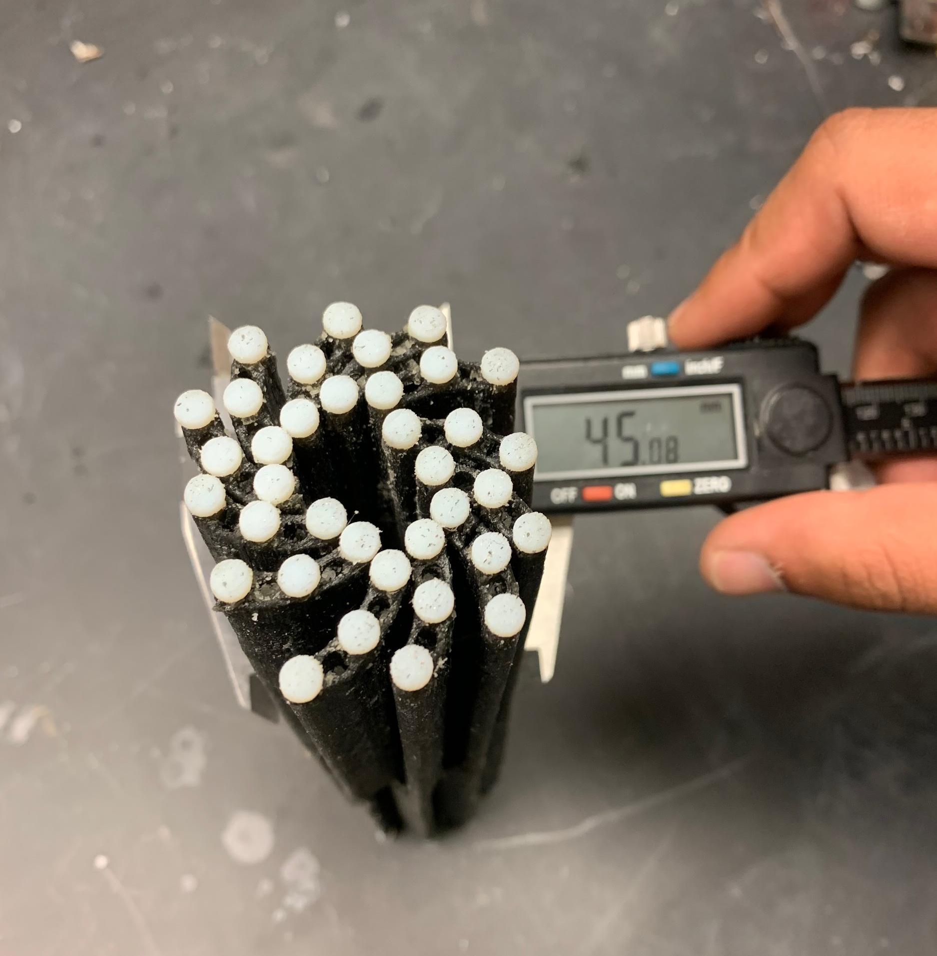
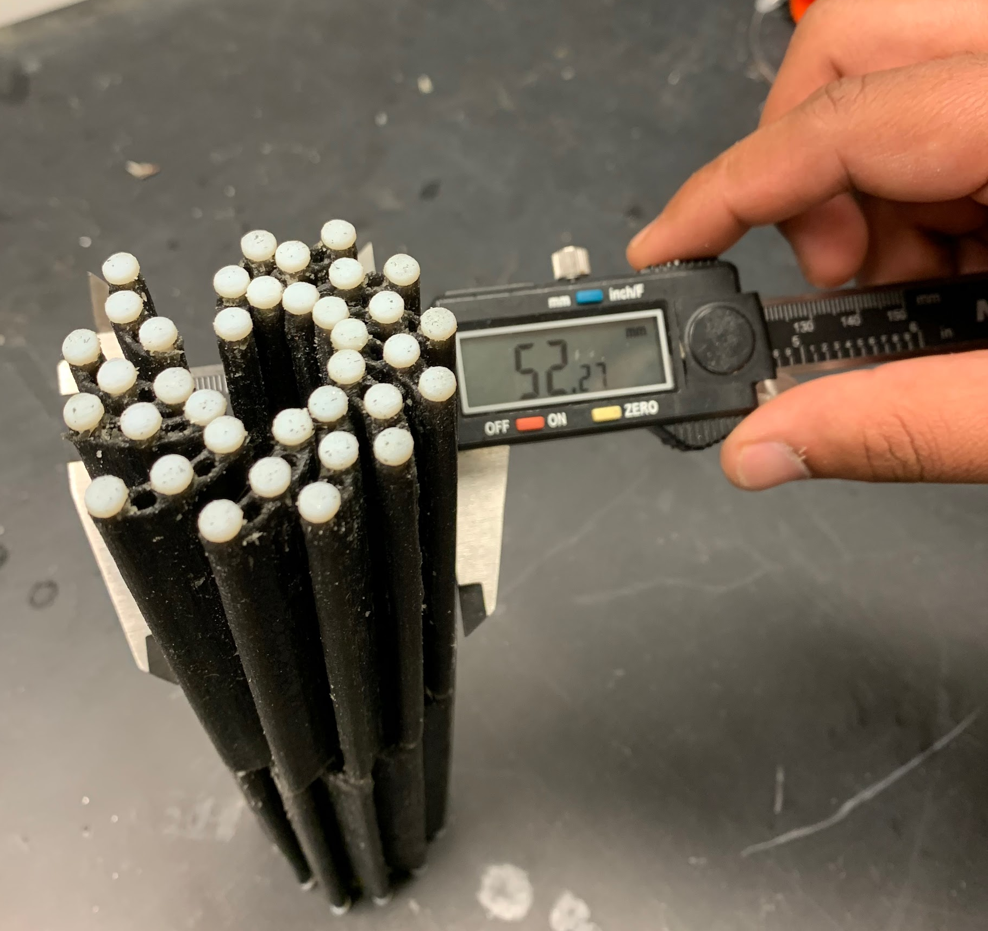
4D Printing Results
Actual diameter ratio:
52.27/45.08 = 1.16
(Compare to 1.29 theoretical)
Was able to open up to
60.10mm with cylinder inserted

Slide 9
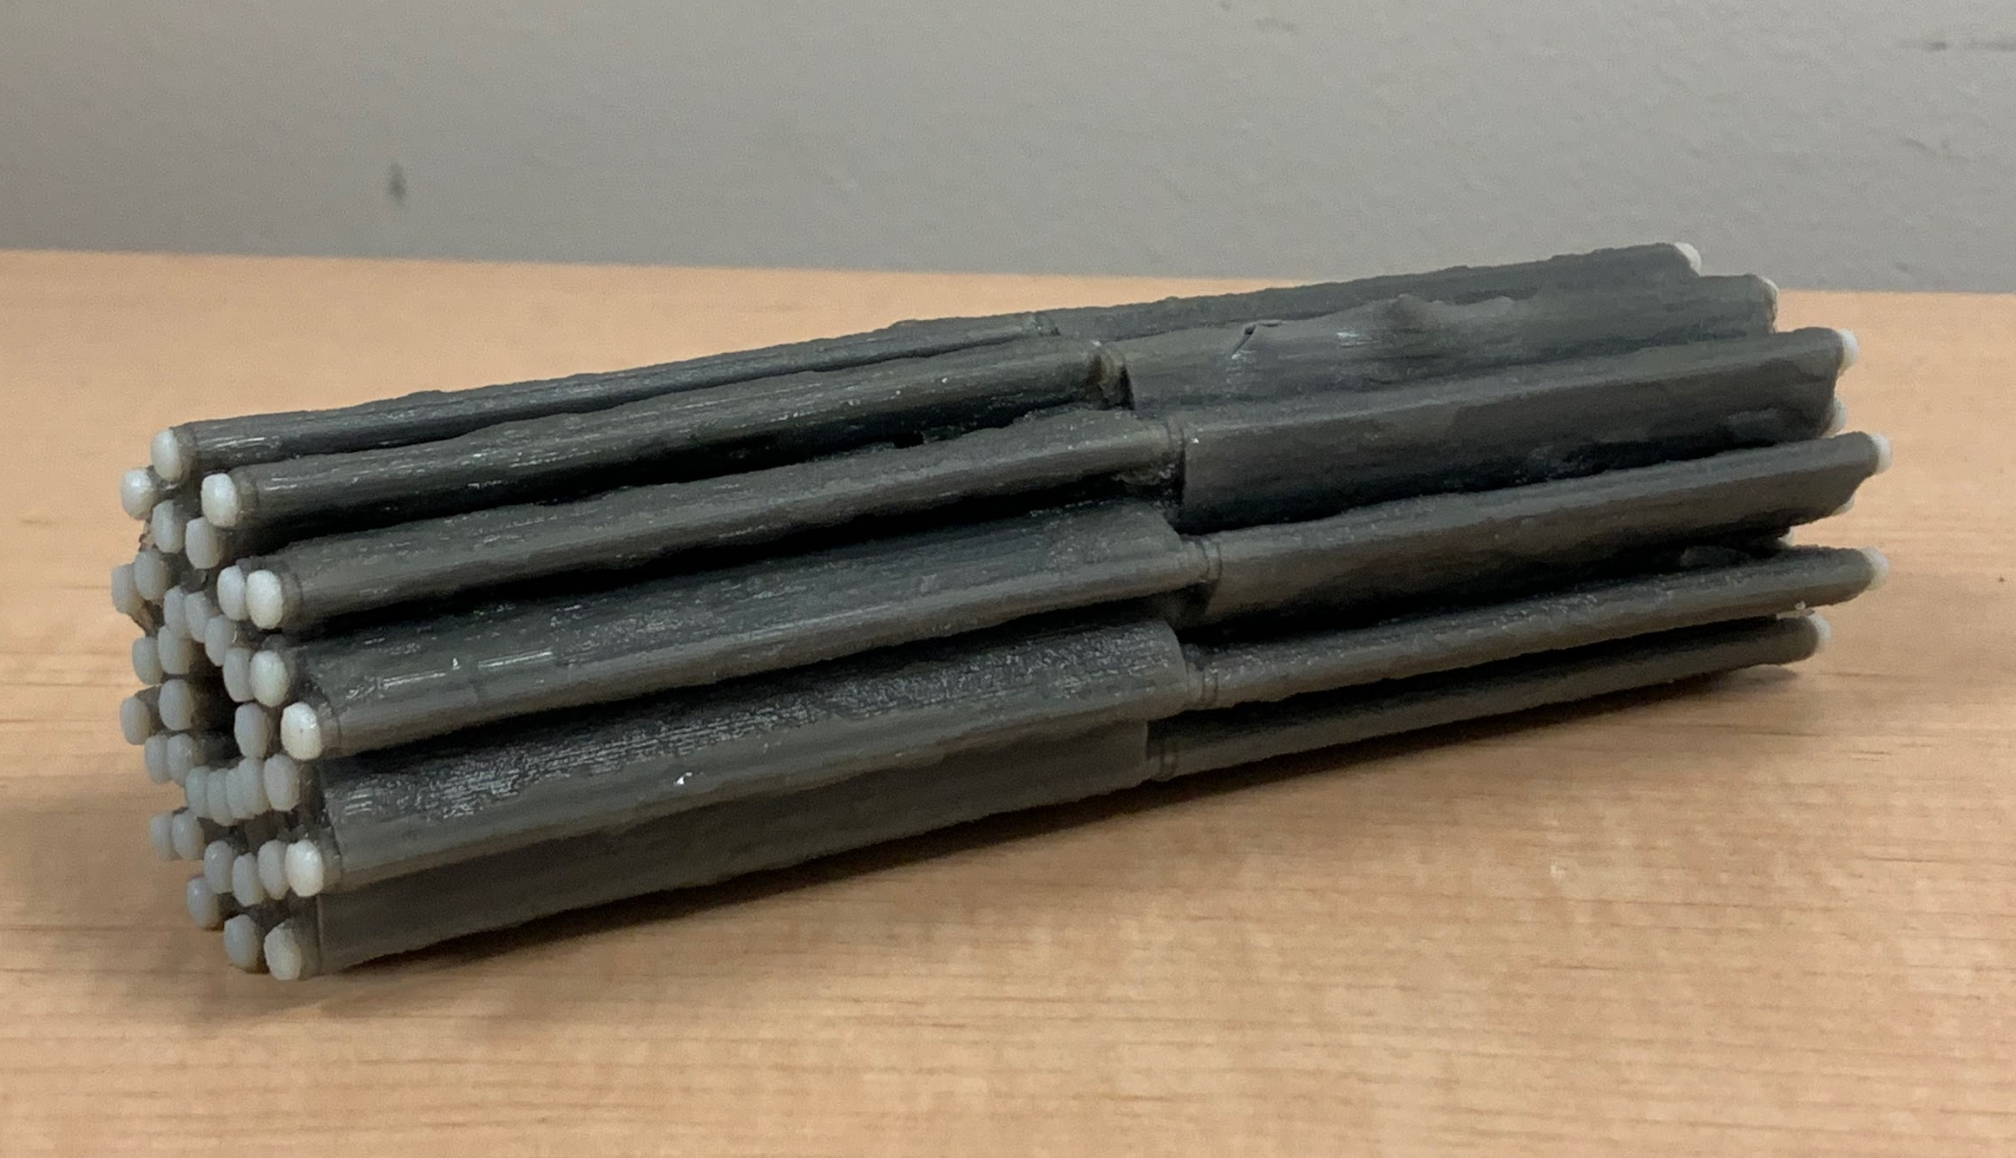
4D Printing Results
Certainly able to hold its shape without external help!
Enough rigid material used so that it
does not collapse under own weight
Notes:
1

Slide 10
Lessons Learned
This would work in theory!
“Water-soluble” =/= soluble by just soaking in water
Would try sodium hydroxide & sodium metasilicate solution if available next time
Notes:
We were disappointed with the results of this print because we knew that this design would work in theory. Dissolving the water-soluble support material was a huge issue, because it did not peel off easily nor did it dissolve in plain water. If we had had access to the sodium hydroxide and sodium metasilicate solution at our labs (or personal use) we feel confident that this design would have had a high ratio of diameters around XX as mentioned previously.

Slide 11
Questions?

